Slide 1
Using the fluorescence microscope

Slide 2
The inverted scope

Slide 3
Objectives are beneath the specimen

Slide 4
Room to manipulate the specimen

Slide 5
Using transmitted light: Turn on the lamp

Slide 6
Point image to eye

Slide 7
Select A for brightfield

Slide 8
Microscope assignment
Stage micrometer to the eye
10X brightfield (A)
10X phase (Ph1)
40X phase (Ph2)
Stage micrometer to the camera (SIDE)
Adjust focus
Adjust light
Adjust exposure time

Slide 9
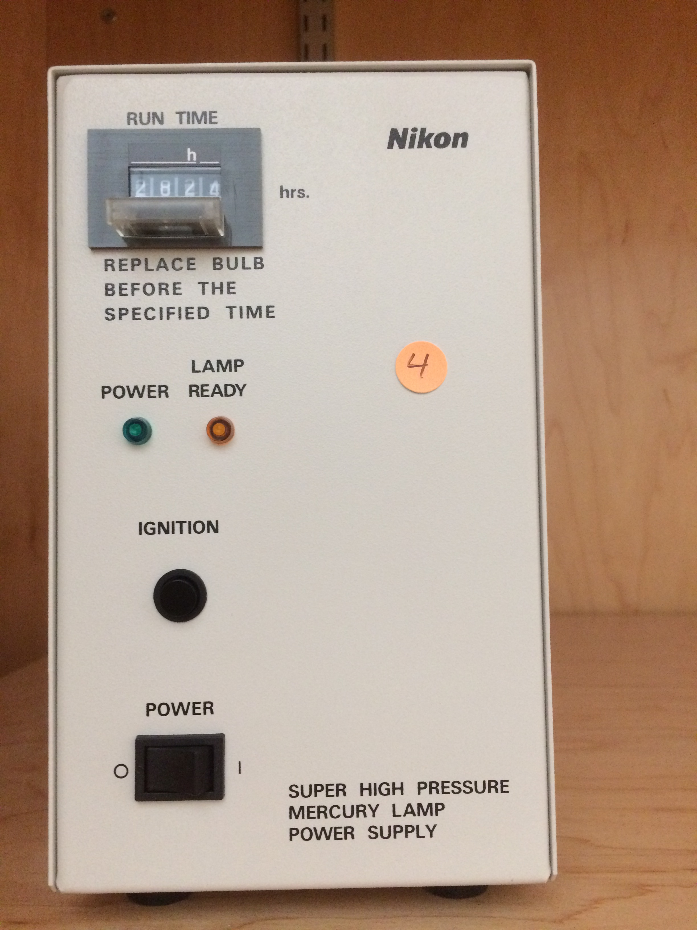
Using emitted light
Turn on the power
Ignite the arc lamp
DO NOT TURN OFF

Slide 10
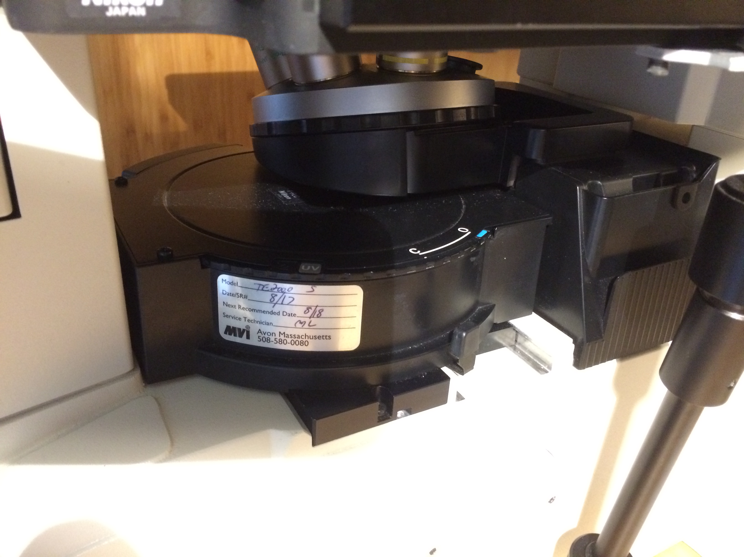
Viewing cells
Get cells in focus in phase
Rotate filter B into place
Blue light shines on specimen, green to eye
Open shutter (O)

Slide 11
Open this shutter, too

