Slide 1
COLOR
A forced march through
Color theory
Anatomy of the retina

Slide 2
Terminology
Hue
Brightness
Saturation
Resolving power
Additive color mixing
Subtractive color mixing
Notes:
Hue: Main color (e.g., red, orange, yellow, etc.).
Brightness: The overall intensity of the light from dark to dazzling, or the total amount of light.
Saturation: The purity of a color. The absence of other colors of the spectrum that would combine to make white (or gray), therefore the degree of difference of a hue from gray (or white) of the same brightness. Red is saturated, pink is unsaturated. (Notice that this is unrelated to brightness.)
Additive color mixing: Mixing lights of different colors so you see them in a single spot simultaneously. The lights are added together.
Subtractive color mixing: Combining the filters through which one light shines (or the pigments off which one light reflects). Each filter subtracts part of the light.
Resolving power: The minimum distance between two objects necessary for a lens to distinguish (resolve) them as distinct objects. [This is a useful idea when you consider color printing and TV screens.] The resolving power of the human retina is a little less than a tenth of a degree.

Slide 3
COLOR THEORY
Additive color mixing
R + G =
Y
R + B =
M
B + G =
C
R + G + B =
W

Slide 4

Color mixing on the computer screen

Slide 5
COLOR THEORY
Subtractive color mixing
W - R =
G + B
= C
W - G=
R + B
= M
W - B =
R + G
= Y
W - R - G - B =
K

Slide 6
COLOR THEORY
Subtractive color mixing, continued
W – R – G =
B
W – G – B =
R
W - R - B =
G

Slide 7
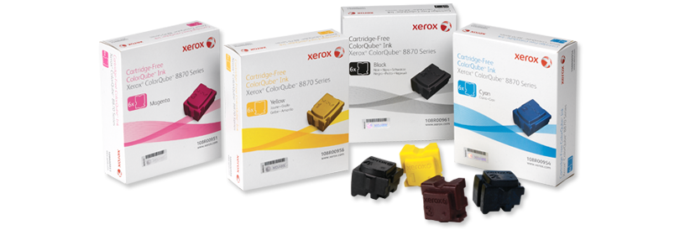
Color mixing on the printed page:
Xerox solid ink colors

Slide 8
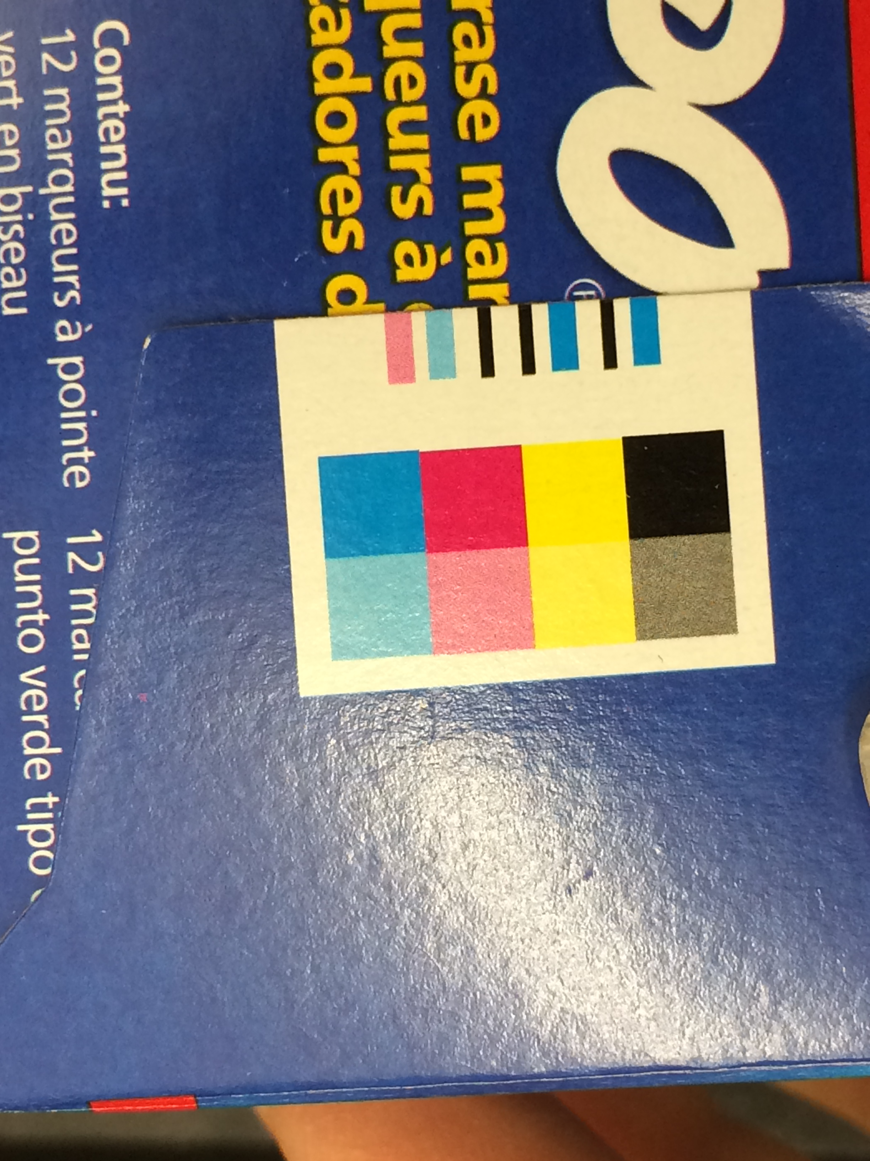
Subtractive color mixing on the printed page: the registration

Slide 9
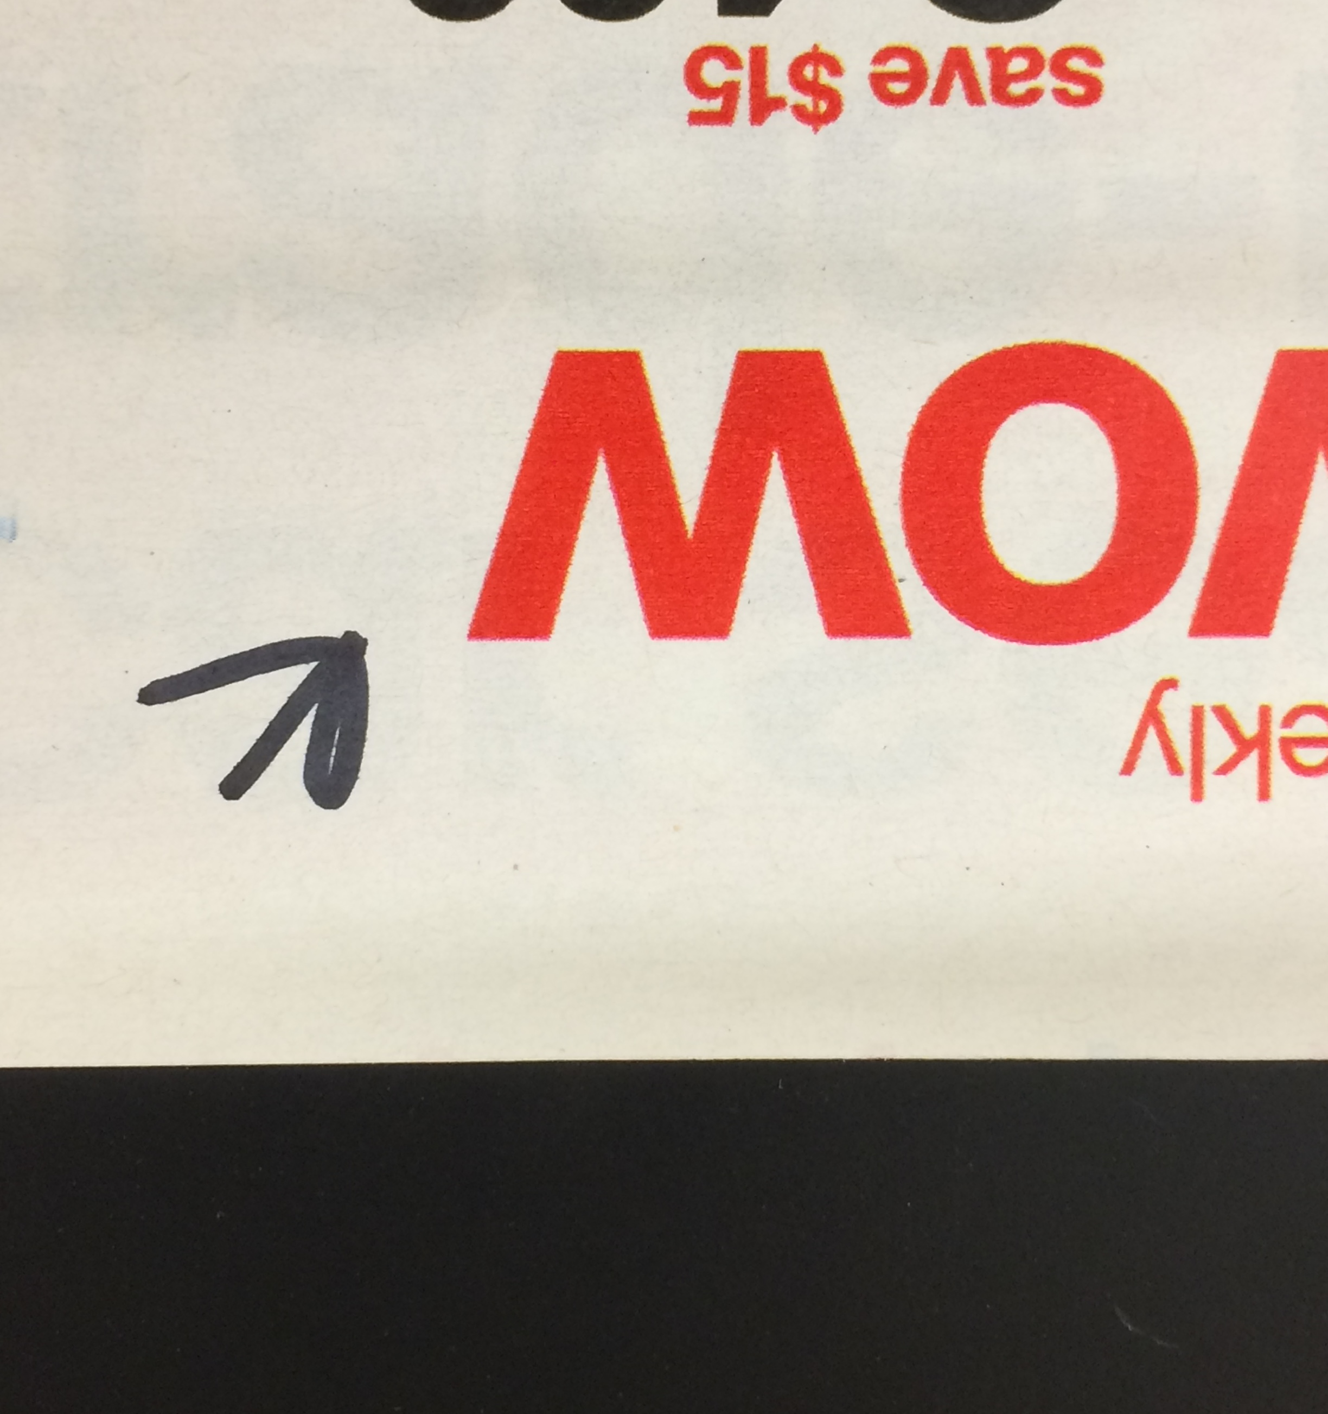
Subtractive mixing on the printed page:
RED

Slide 10

RED, Magnified

Slide 11
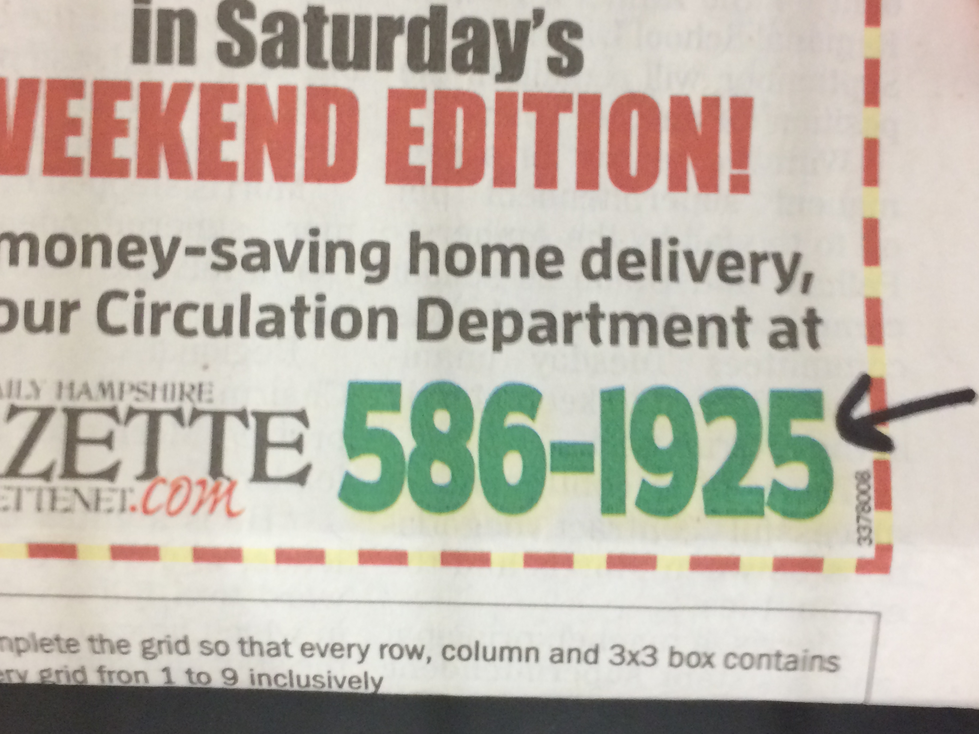
Subtractive mixing on the printed page:
GREEN

Slide 12
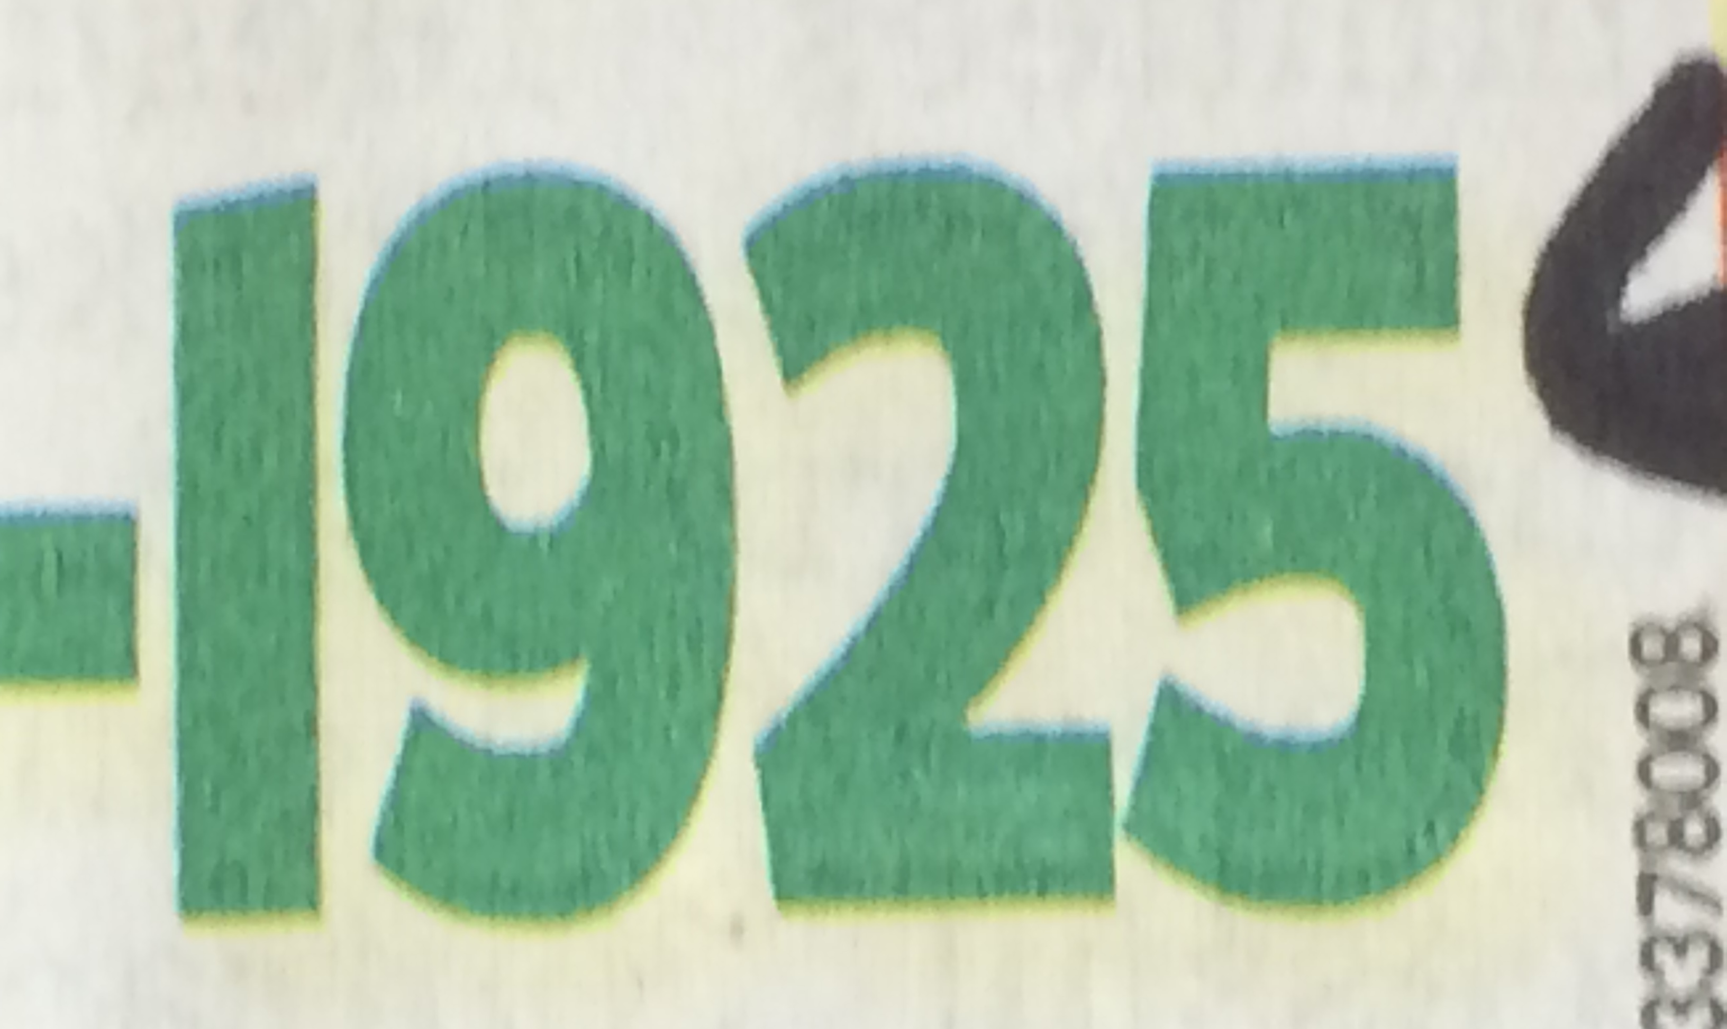
GREEN, Magnified

Slide 13
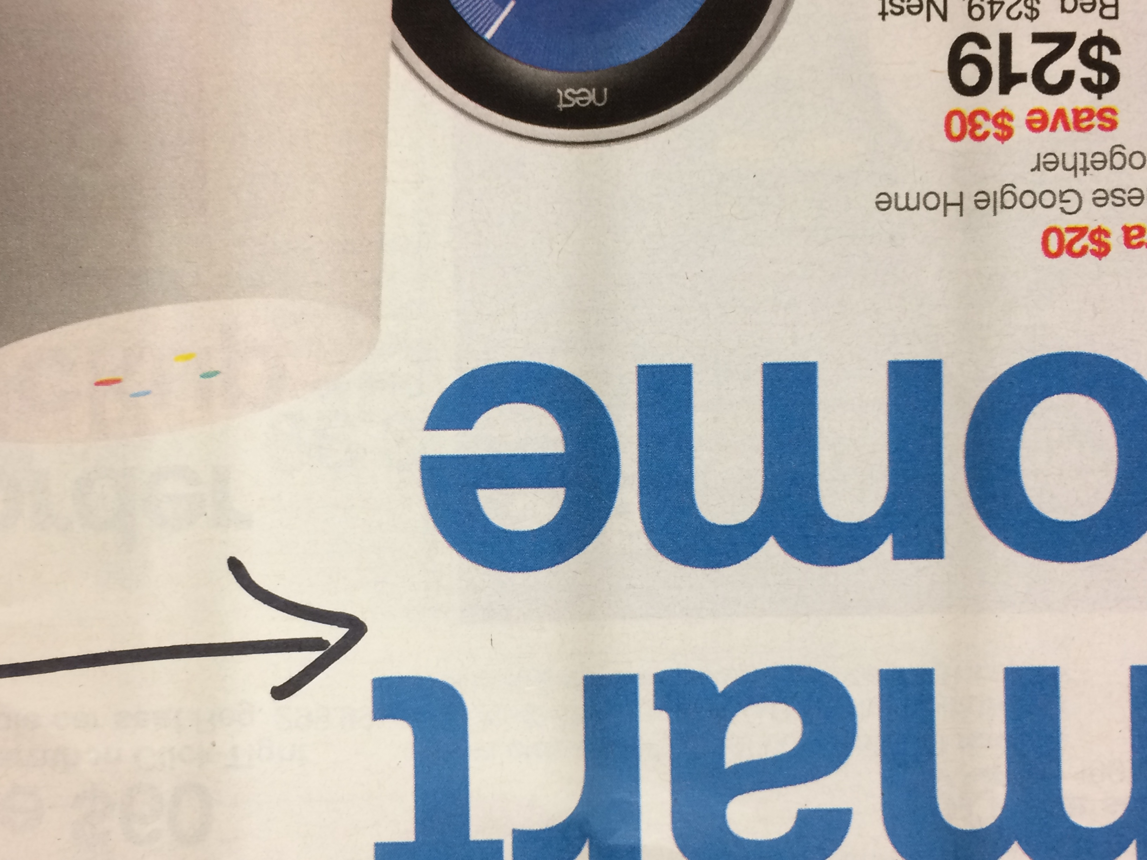
Subtractive mixing on the printed page:
BLUE

Slide 14

BLUE, Magnified

Slide 15

Why does this work?

Slide 16
I’m afraid you’ll find it’s a bit more complicated than that.

Slide 17
Anatomy of the Retina
Human eye
at Molecular Expressions Optical Microscopy Primer

Slide 18
Receptive Fields

Slide 19
Resolving Power

Slide 20
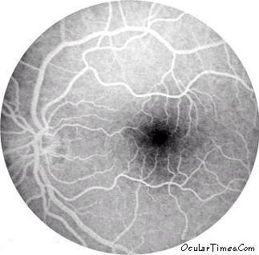
Blind spot
Nasal side temporal side

Slide 21
What receptors are in the fovea?
● | ● | ● | ● | ●
● | ● | ● | ● | ●

Slide 22



Color Opponency

Slide 23
Center/Surround Opponency
individual photoreceptors
R G B
receptive field
R G B
Retina
excitation
excitation
inhibition
excitation
inhibition
to higher brain levels
inhibition
blue center/yellow surround double opponent ganglion cell

