Slide 1
COLOR
A forced march through
Color theory
Anatomy of the retina

Slide 2
Terminology
Hue
Brightness
Saturation
Resolving power
Additive color mixing
Subtractive color mixing
Notes:
Hue: Main color (e.g., red, orange, yellow, etc.).
Brightness: The overall intensity of the light from dark to dazzling, or the total amount of light.
Saturation: The purity of a color. The absence of other colors of the spectrum that would combine to make white (or gray), therefore the degree of difference of a hue from gray (or white) of the same brightness. Red is saturated, pink is unsaturated. (Notice that this is unrelated to brightness.)
Additive color mixing: Mixing lights of different colors so you see them in a single spot simultaneously. The lights are added together.
Subtractive color mixing: Combining the filters through which one light shines (or the pigments off which one light reflects). Each filter subtracts part of the light.
Resolving power: The minimum distance between two objects necessary for a lens to distinguish (resolve) them as distinct objects. [This is a useful idea when you consider color printing and TV screens.] The resolving power of the human retina is a little less than a tenth of a degree.

Slide 3
COLOR THEORY
Additive color mixing
R + G =
Y
R + B =
M
B + G =
C
R + G + B =
W

Slide 4

Color mixing on the computer screen

Slide 5
COLOR THEORY
Subtractive color mixing
W - R =
G + B
= C
W - G=
R + B
= M
W - B =
R + G
= Y
W - R + G + B =
K

Slide 6
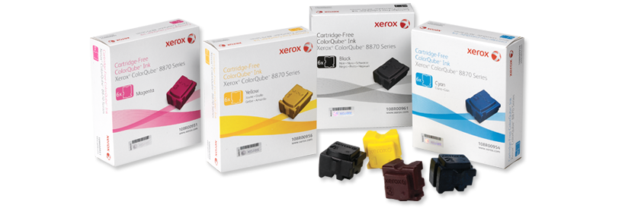
Color mixing on the printed page:
Xerox solid ink colors

Slide 7
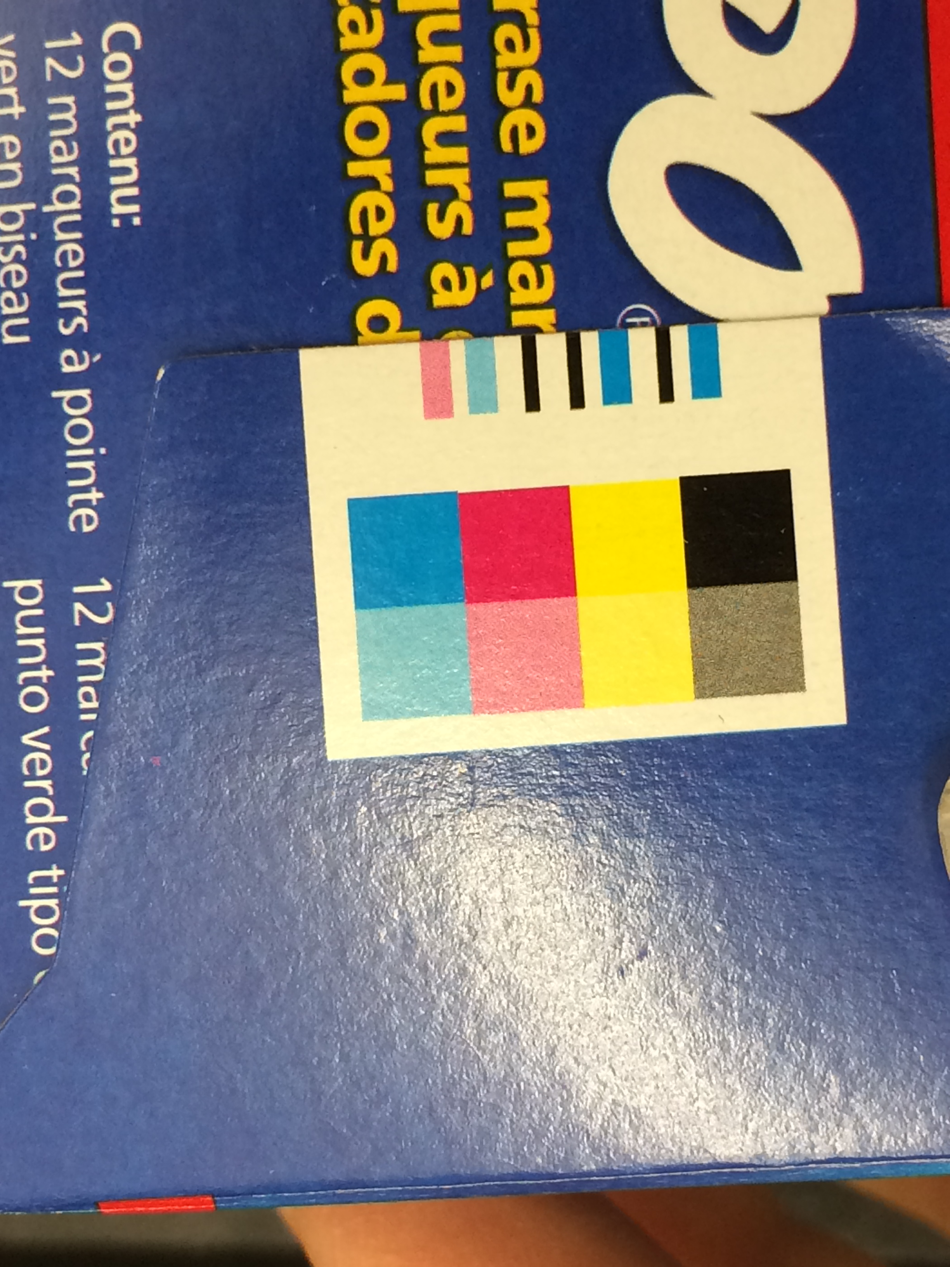
Subtractive color mixing on the printed page: the registration

Slide 8
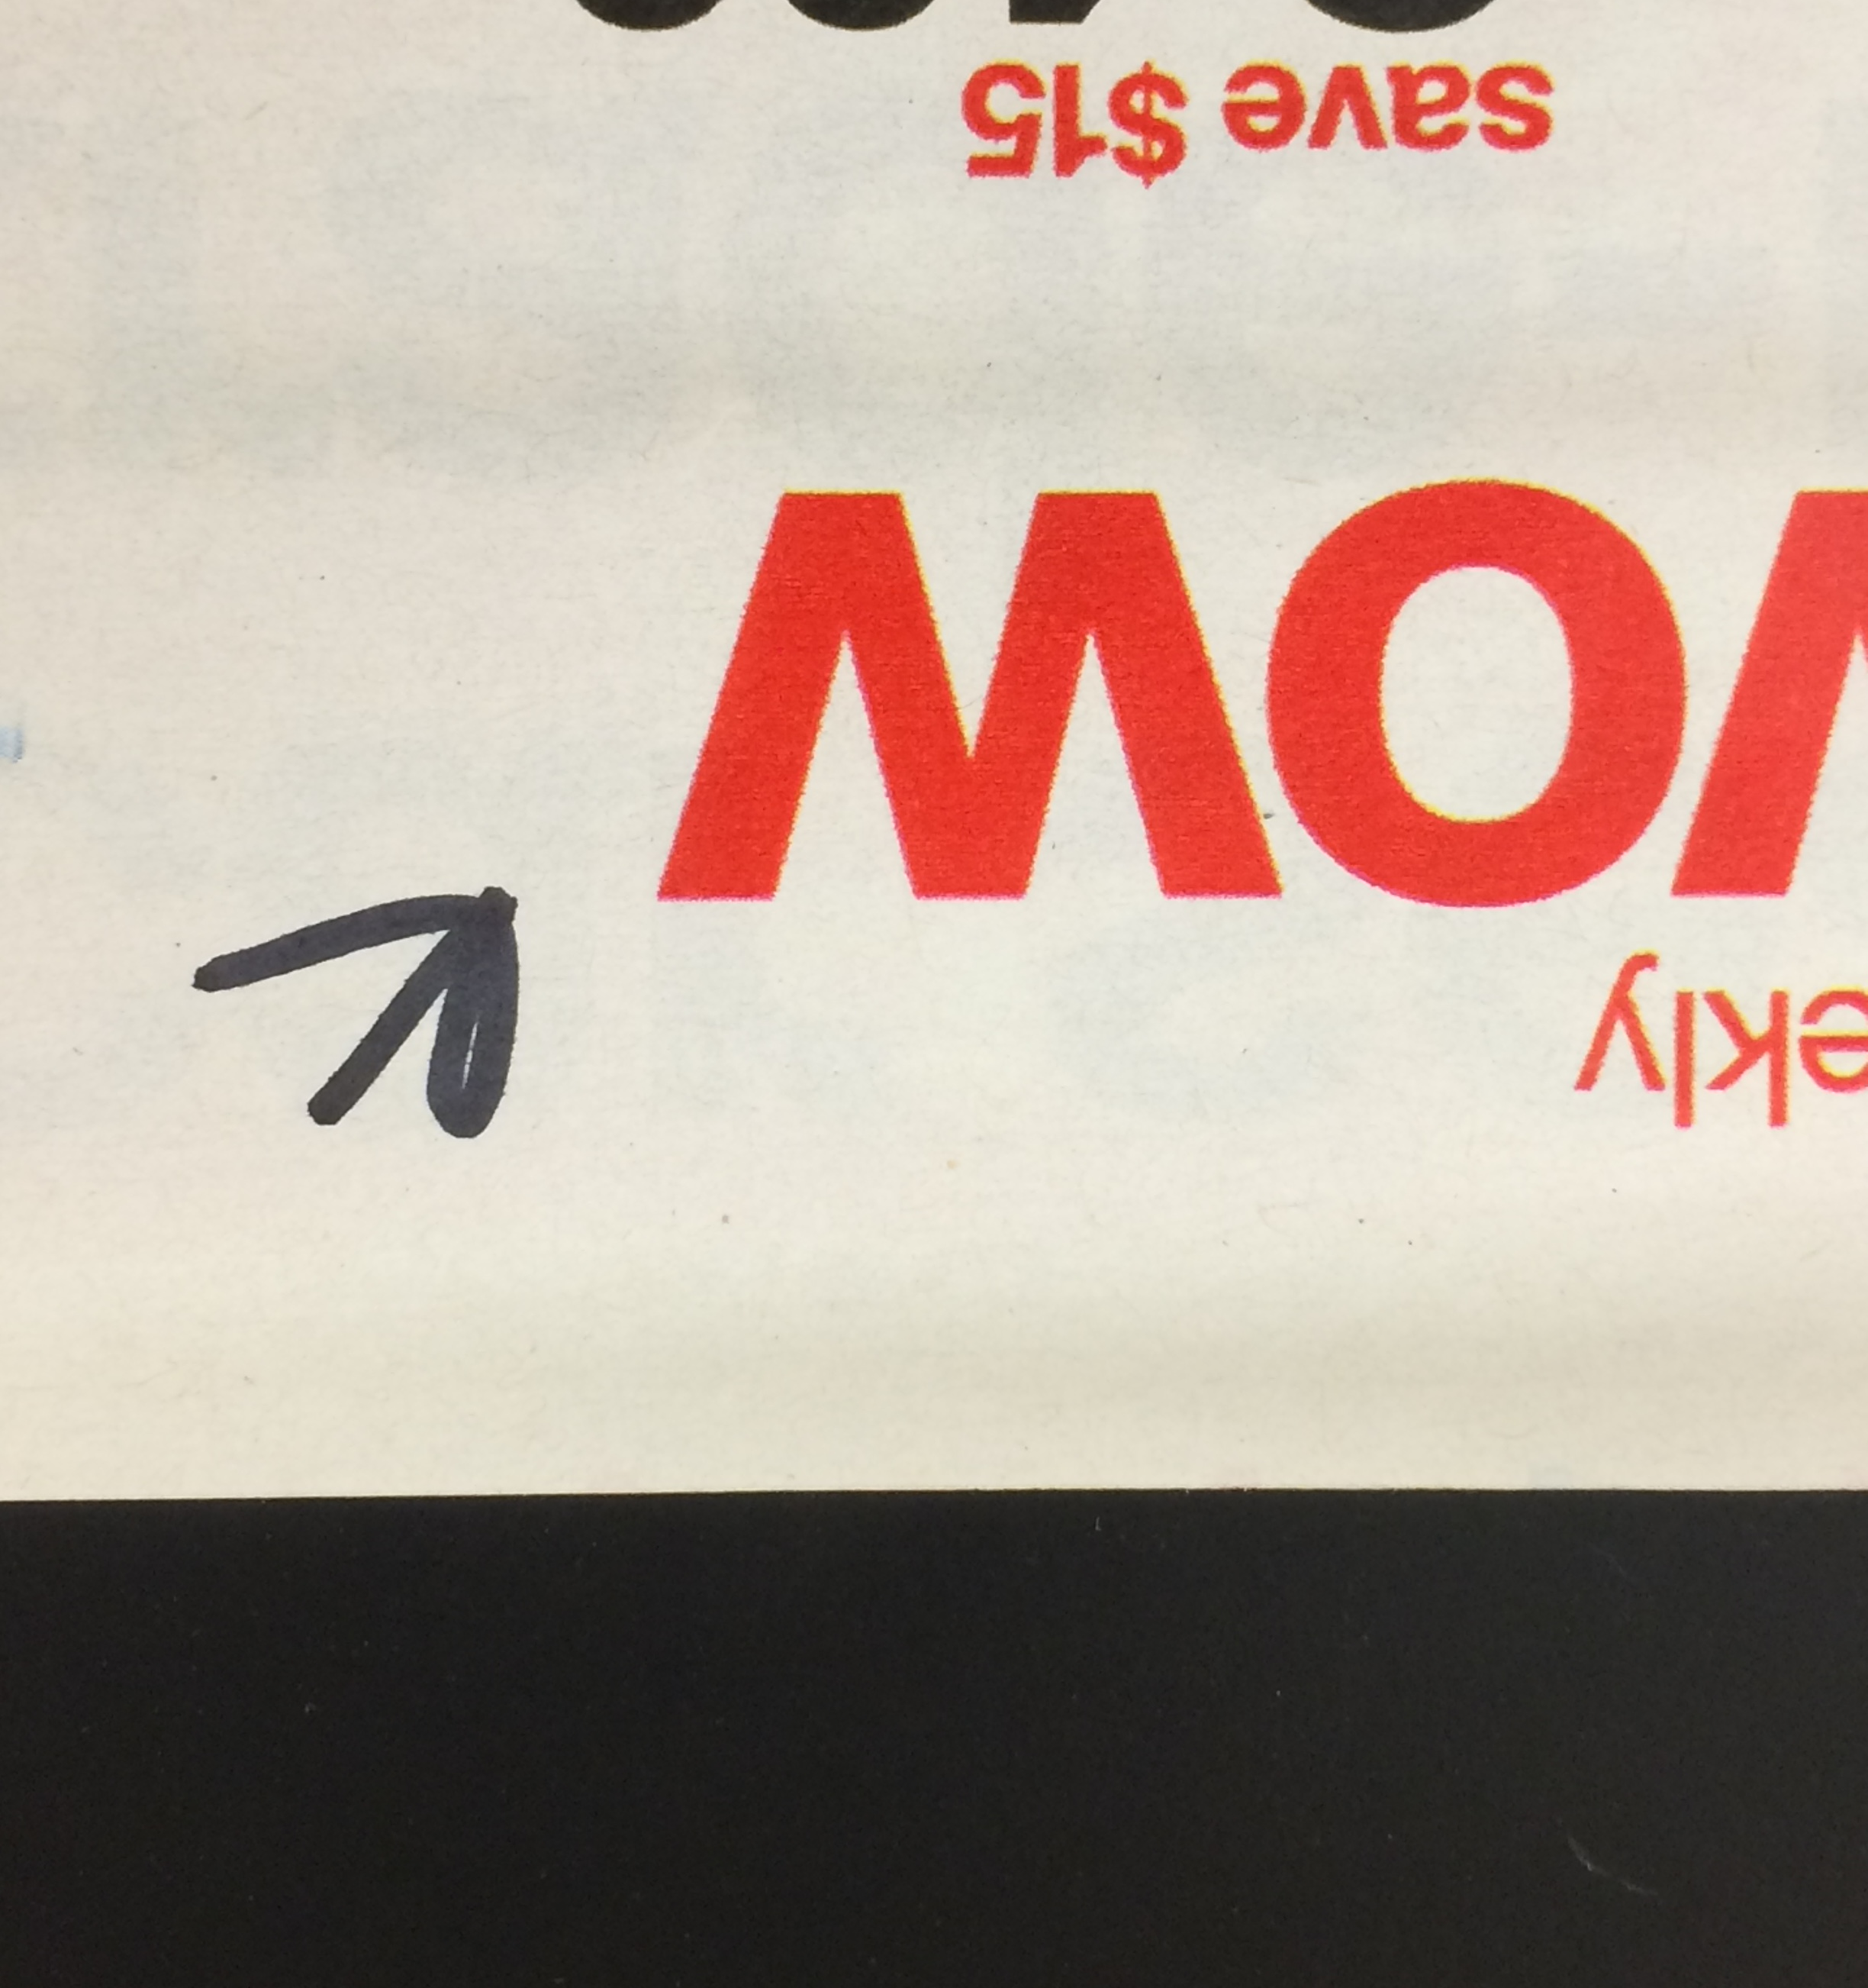
Subtractive mixing on the printed page:
RED

Slide 9

RED, Magnified

Slide 10
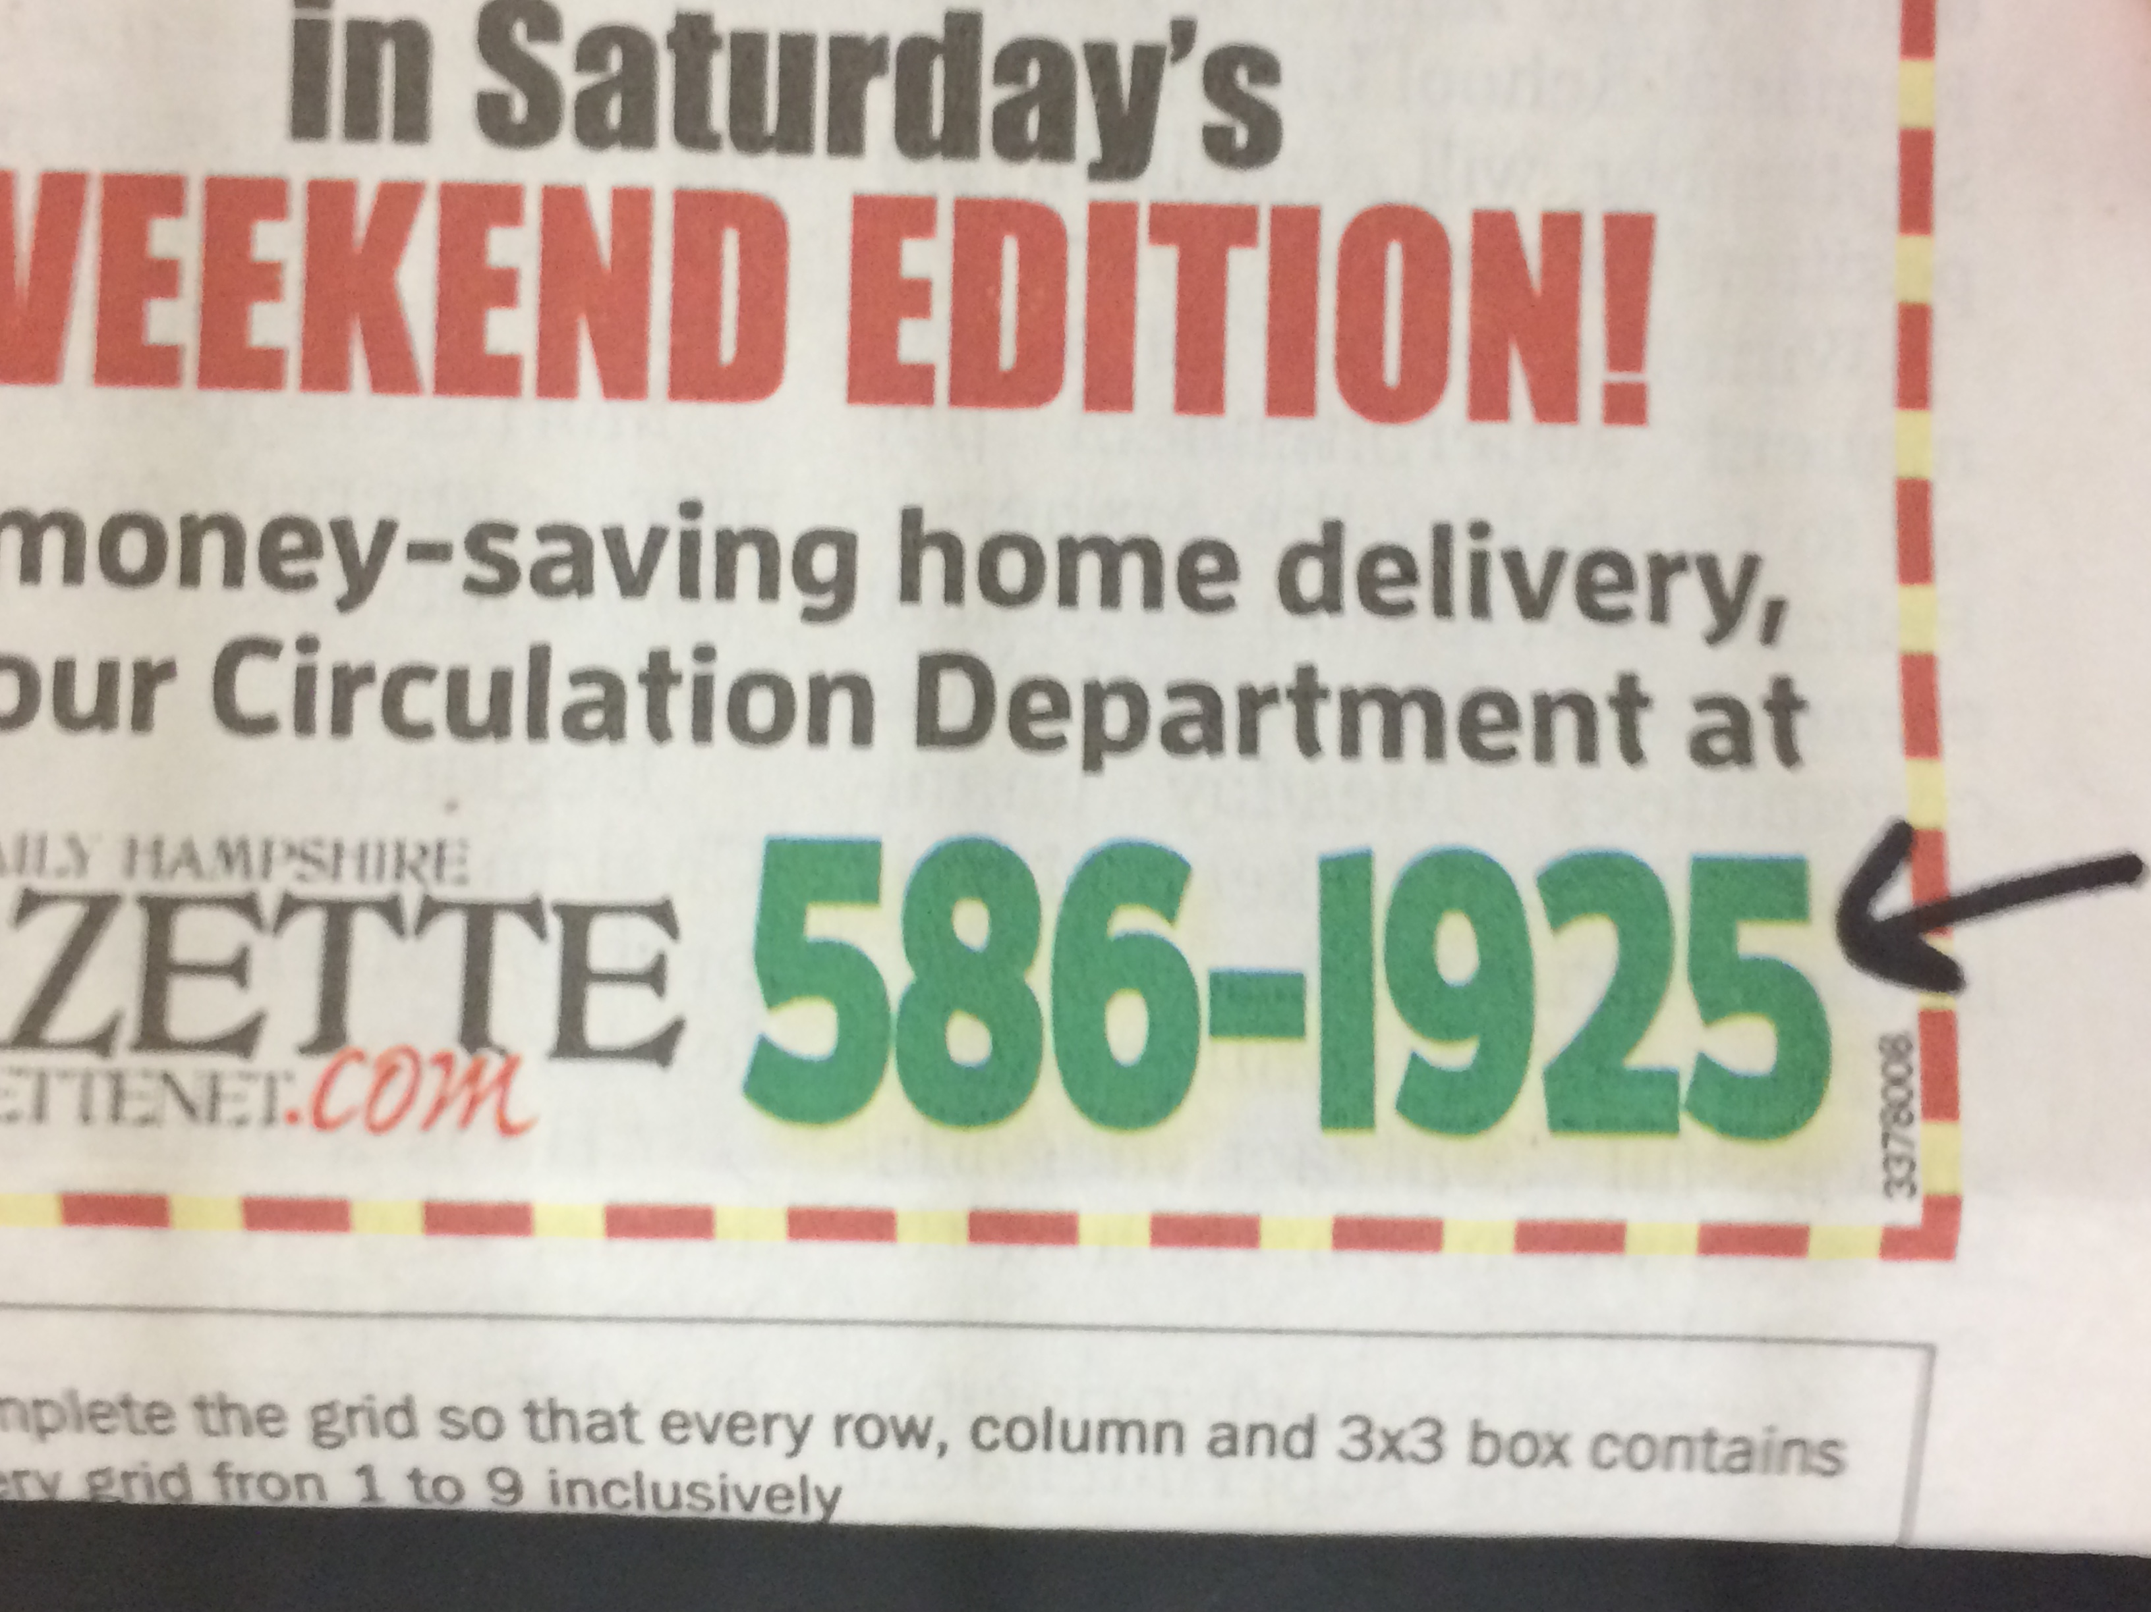
Subtractive mixing on the printed page:
GREEN

Slide 11

GREEN, Magnified

Slide 12

Subtractive mixing on the printed page:
BLUE

Slide 13

BLUE, Magnified

Slide 14
Why does this work?
Visible spectrum
Visual Pigments
at Molecular Expressions Optical Microscopy Primer

Slide 15
I’m afraid you’ll find it’s a bit more complicated than that.

Slide 16
Anatomy of the Retina
Human eye
at Molecular Expressions Optical Microscopy Primer
Multiple interactions

Slide 17
Receptive Fields

Slide 18
Resolving Power

Slide 19
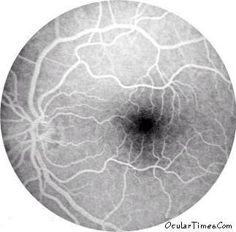
Blind spot
Nasal side temporal side

Slide 20
What receptors are in the fovea?
● | ● | ● | ● | ●
● | ● | ● | ● | ●

